Slide 1

How Is Education Different Now Than It Was In The 70’s
Group Presentation Assignment 2024

Slide 2
Group Presenters
Presenters:
1)Muhammad Ahmed Syed 2) Raiyan Farhaz 3)Ryan Malidina
Course: Communication And Application.
Programme: Mobile And Web Computing.
Department: Information Technology.

Slide 3

Introduction
Education is the process of acquiring knowledge, skills, values and attitudes that helps individuals grow and develop. Education plays the greatest role in shaping individuals and societies. Education and schooling has been a part of human civilization for thousands of years. But education and learning system had a drastic change from the past and now. Like in the 70’s education relied more on traditional teaching methods like lectures and textbooks. But nowadays, everyone has access to advanced technologies,interactive teaching tools and online learning. Additionally, there has been a shift towards more student-centered and collaborative learning approaches, rather than only memorizing a topic. Thus, the evolution of education as been really exiciting.
Purpose of this comparison is to examine the changes,improvements and advancements of education system between now and in the 70’s. We can witness how the advancement of technologies has impacted the teaching method in the recent years.

Slide 4
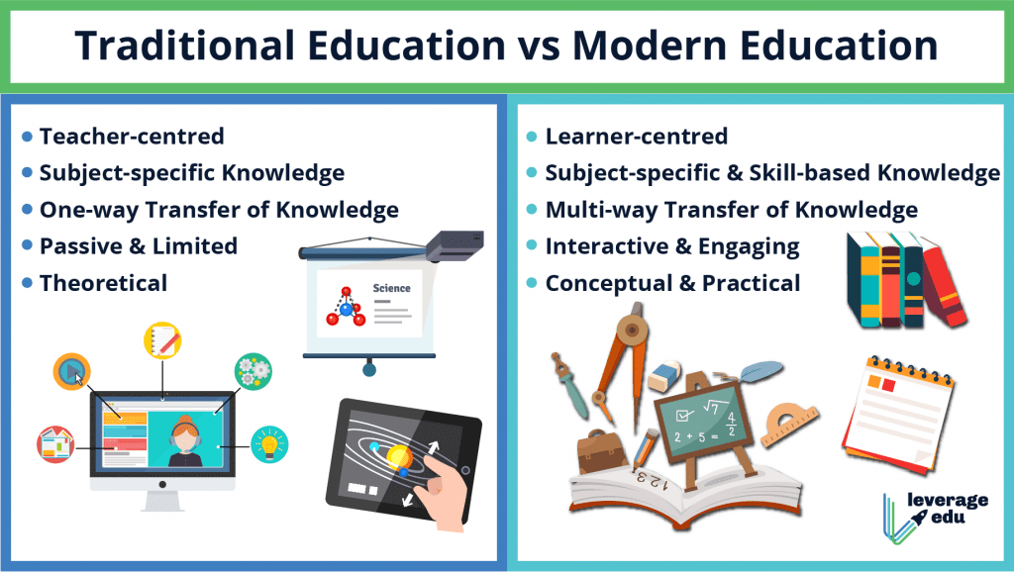
In the past when it comes to education, there was a sense of nostalgia of the simpler times, traditional teaching methods and personal connection between teachers and students. But in the present time technologies gives us access to vast information and more interactive learning experiences. Therefore, it is a balance between cherishing the past and embracing advancements of the present.

Slide 5
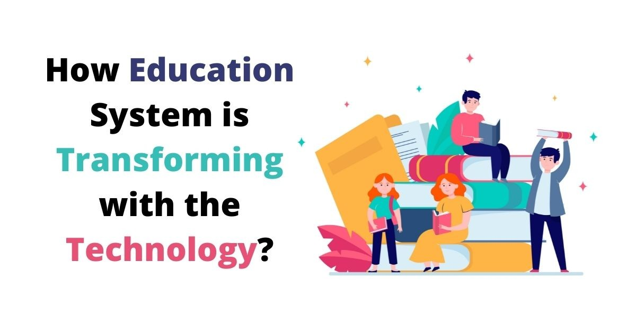
Main Body
Technological Advancements: In the 70’s education was mostly relied on textbooks and classrooms relied on traditional looks and chalkboards. Nowadays, due to technologies students can have interactive learning experiences, online resources, virtual classrooms etc. Students can learn things anytime by watching youtube videos and if they wanna know about certain facts they can search for their answers in google and know about so many things in few minutes. Thus, Technological advancements made education and learning system a lot easier.

Slide 6

Globalization and Access: Due to the technological advancements and internet, educational resources are more accessible than before. Online platforms, such as e-learning websites and virtual classrooms have made it possible for students to access quality education regardless of their geographical location. Additionally, globalization has led to the sharing of educational best practices and innovative teaching methods across borders, improving the overall quality of education globally.

Slide 7
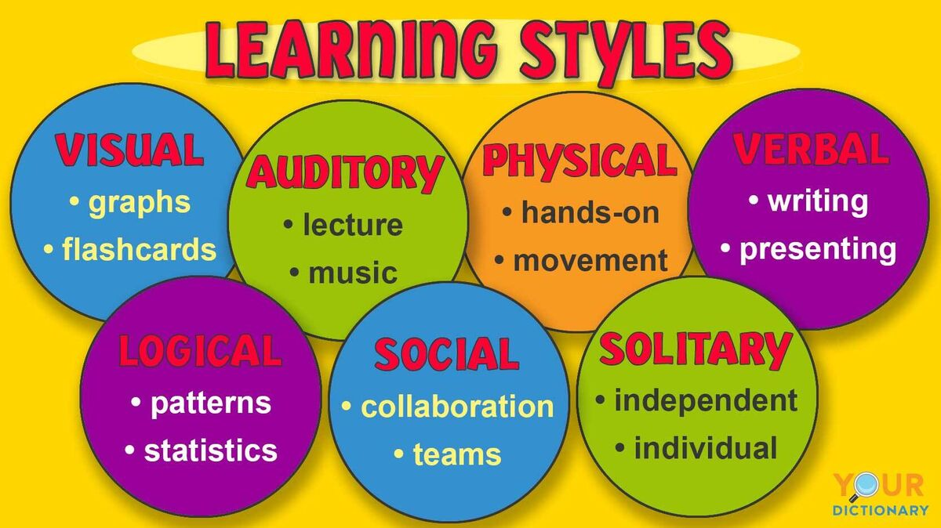
Different Learning Methods: In the 70’s education system leaned towards more memorization. On the other hand, modern education emphasizes student centered learnings, critical learnings, creativity and collaboration. New ideas are more appreciated nowadays.

Slide 8
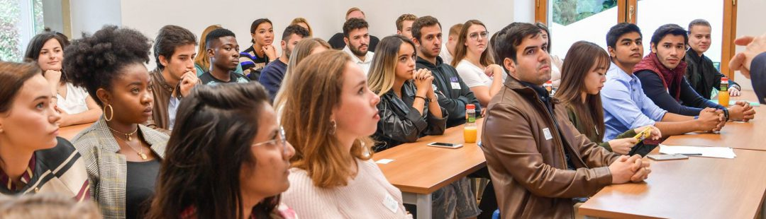
Diversity and Inclusion: While the 70’s had limited attention to diversity and inclusion, modern education strives for equity welcoming learners from diverse backgrounds and addressing systemic barriers to education and learning about diverse cultures too.

Slide 9

Conclusion
Good and bad aspects of modern education system: Modern education has embraced technological advancements, making learning more interactive and easy. Students can learn and know about things in any time and learn things at their own pace. But despite it’s benefits, there are some challenges too. Increased reliance on technology can lead distractions and reduce face to face interaction. Also plagiarism became more common these days.

Slide 10
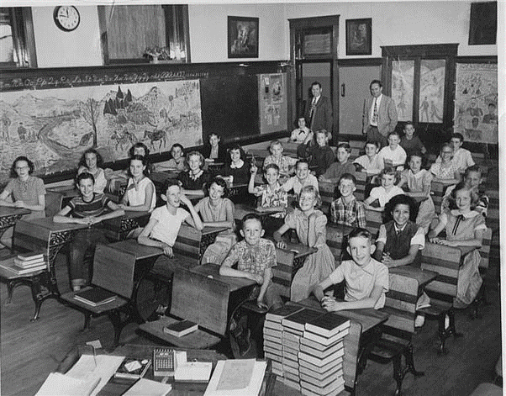
Good and bad aspects of 70’s education system: In 70’s education system emphasized strong foundation knowledge and focused more on core subjects like Maths, Science, language arts. More emphasis was given on discipline and respect for authorities. But the teaching methods were more rigid and depended more on memorization. Critical and creative thinkings were not always encouraged

Slide 11

Future Education System: In the future education will be even more accessible, technology driven and personalized. More importance should be given on critical thinking, creativity and also the adaptability of the students in order to prepare them for the ever evolving world. Finally, we should be optimistic about the future education system acknowledging the challenges but also the exciting possibilities that lies ahead.

Slide 12
Thank You

